Slide 1
Project Read!
How do the books get to the kids?

Slide 2
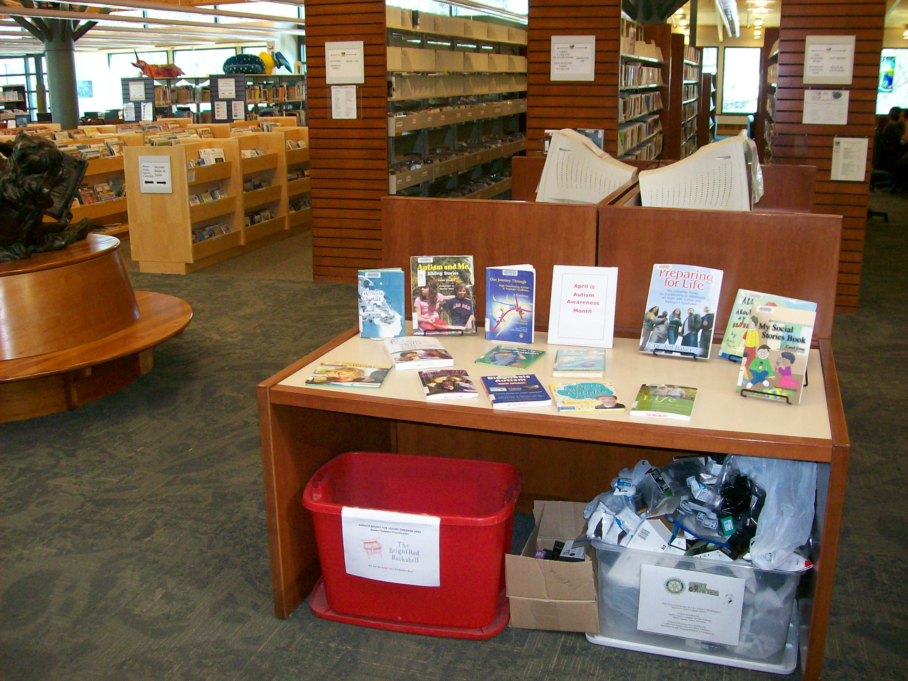

Slide 3
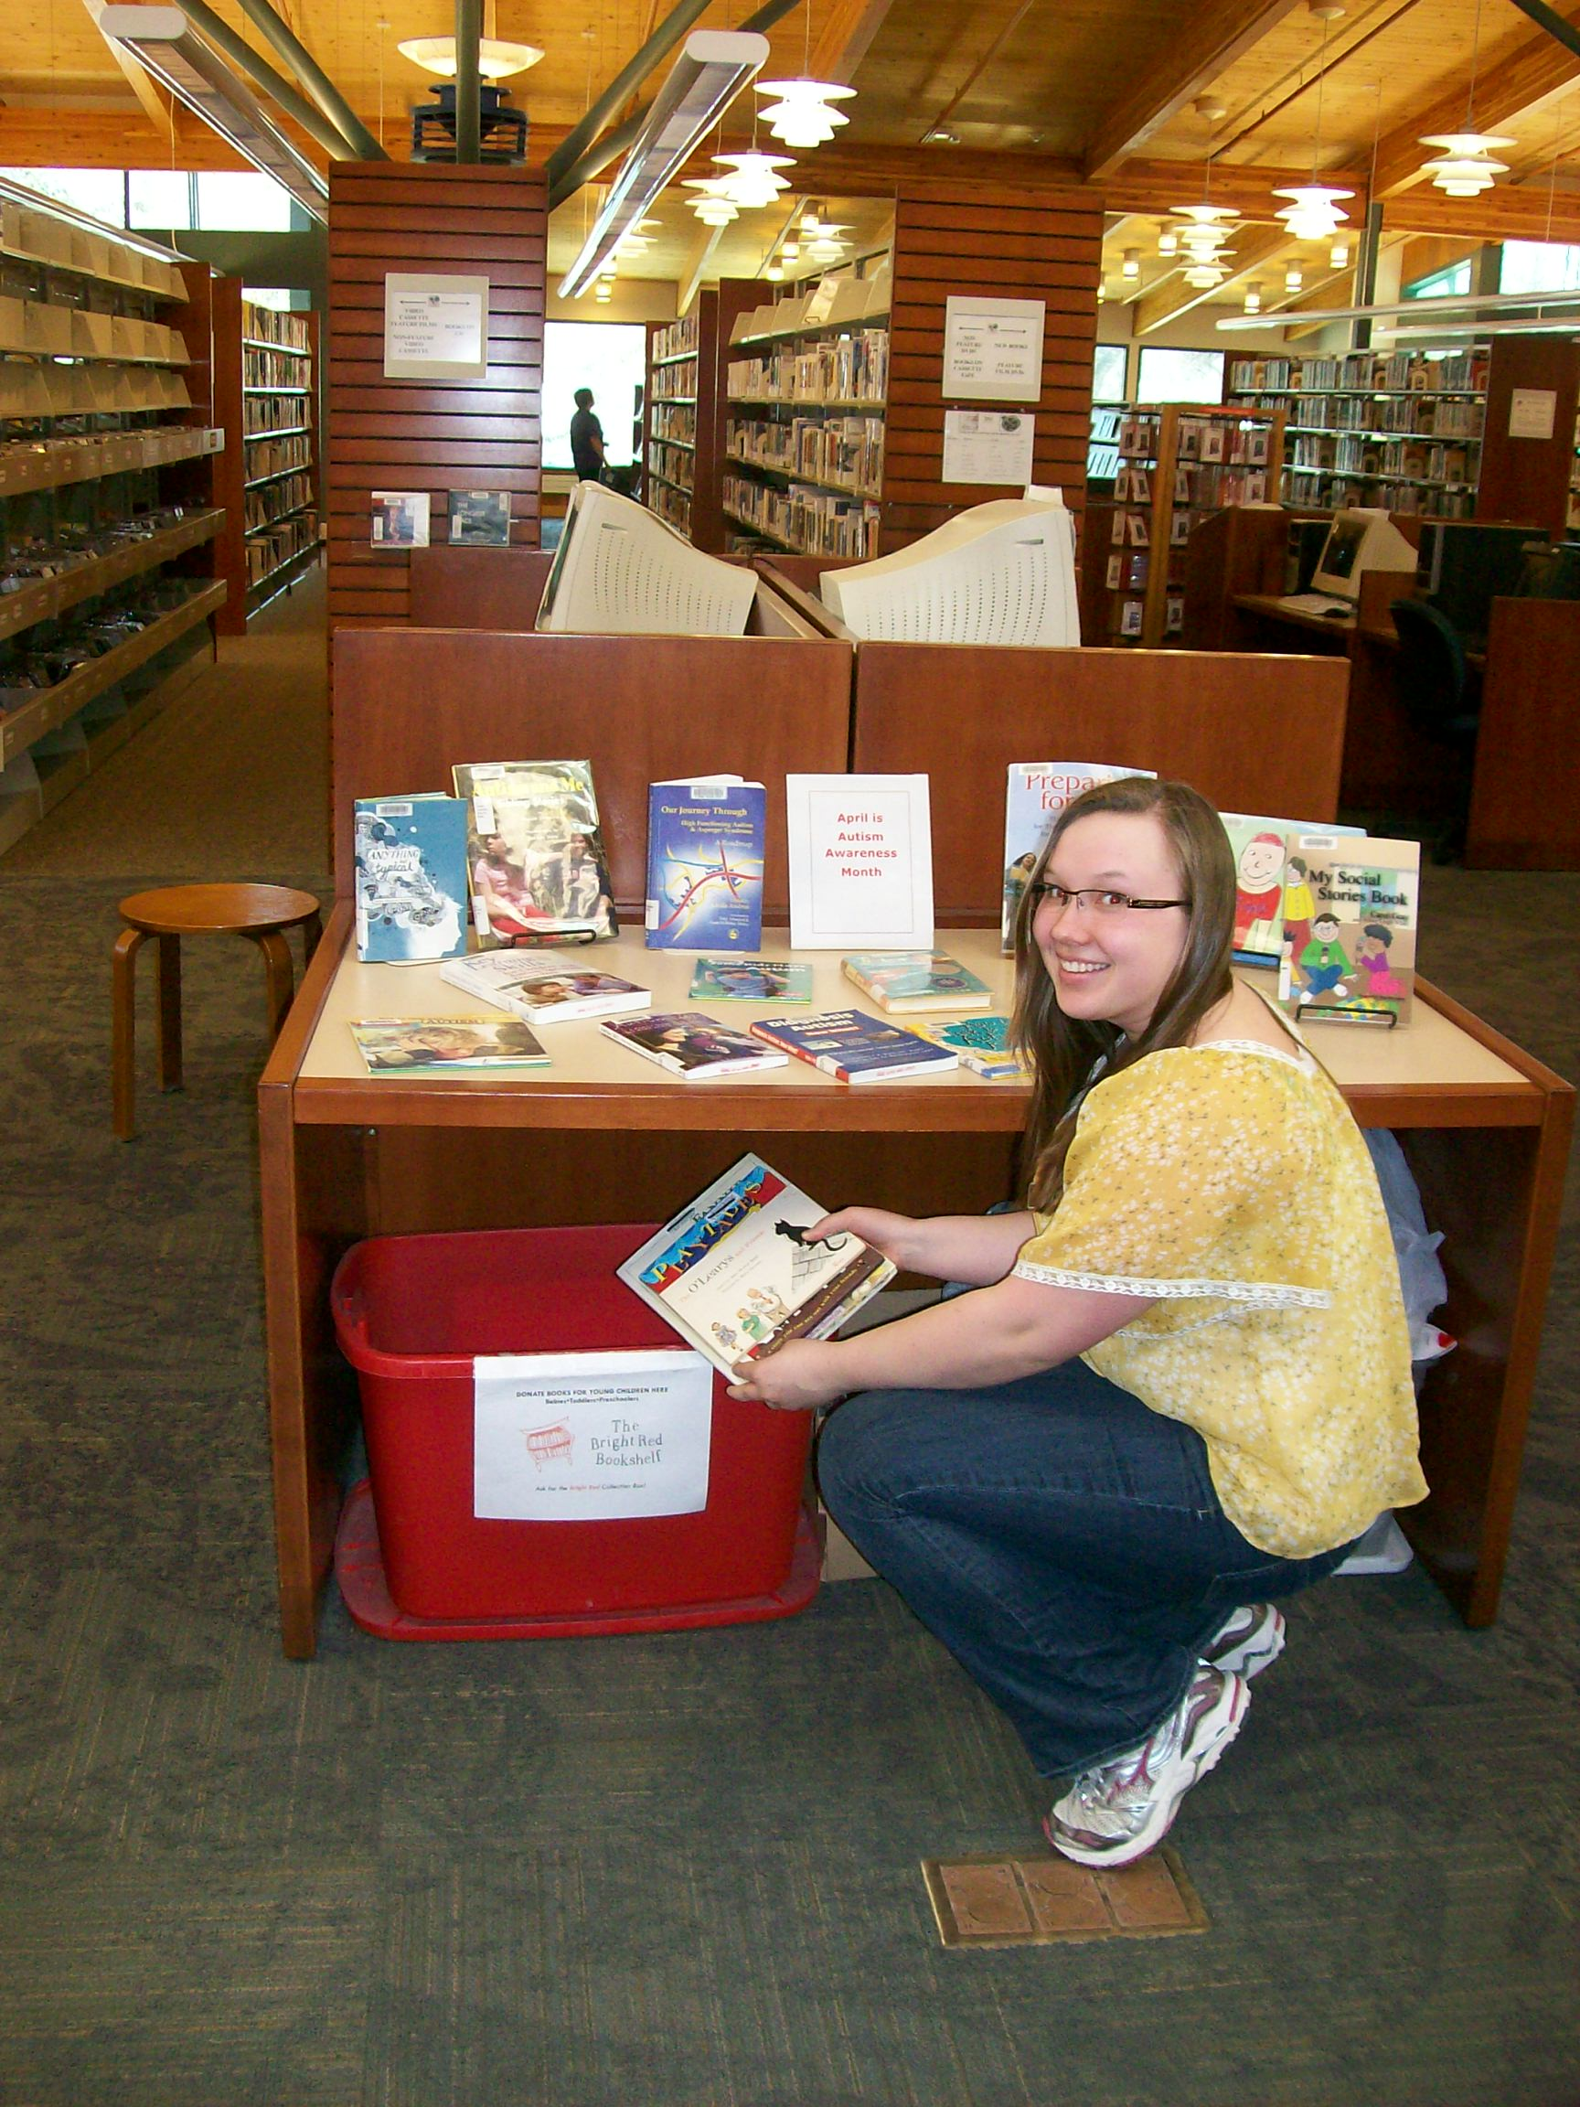

Slide 4
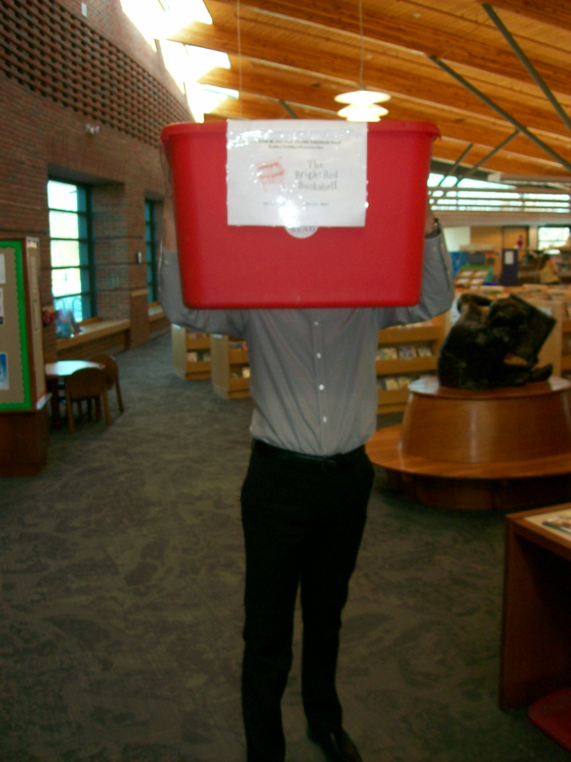

Slide 5
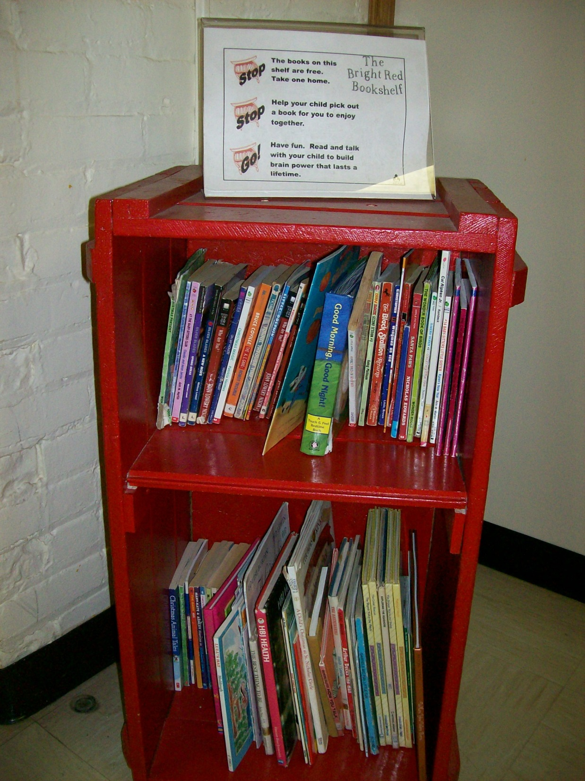

Slide 7
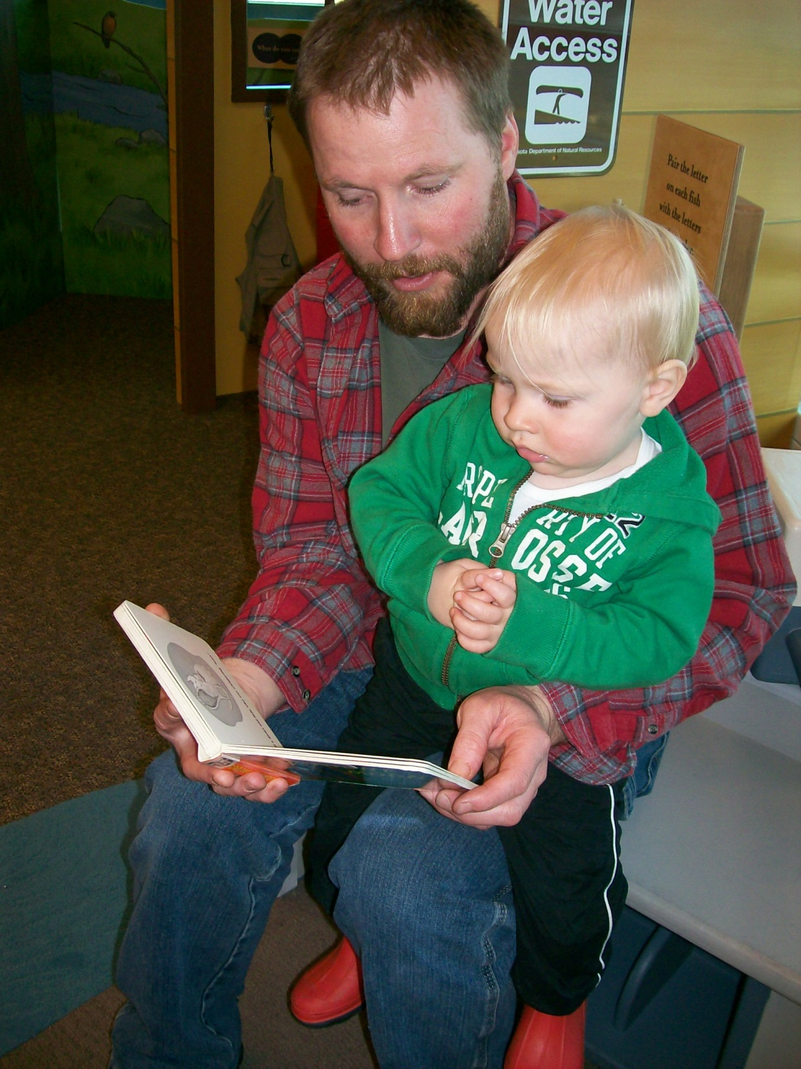

Slide 8
(This is your part)“But, Tracy, what else does Project Read do?”

Slide 9
Wow! Thanks for asking! It’s all about getting the word out:

Slide 10
The web site has lots of good information, including lots of stuff to download and share!
www.projectread.net

Slide 11
Project READ
(Best to link from the web site…there are a LOT of project reads!)

Slide 12
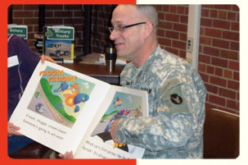
FRED* Events!
*Fathers Read Every Day!

Slide 13
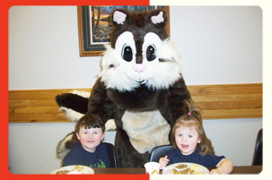
Chippy appearances!

Slide 14
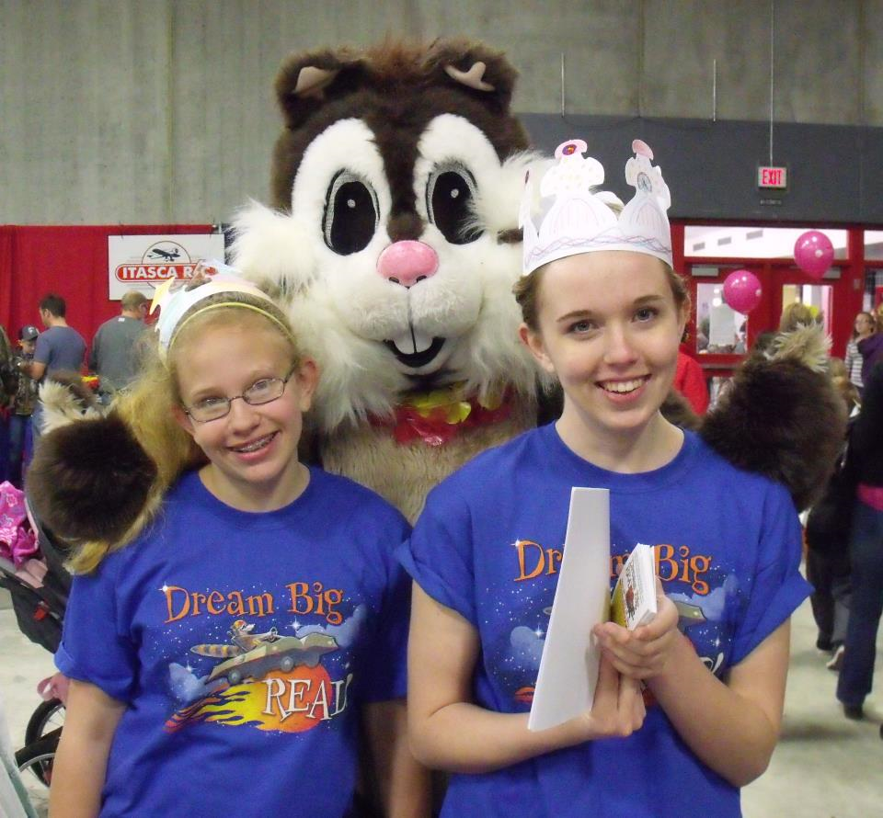

Slide 15
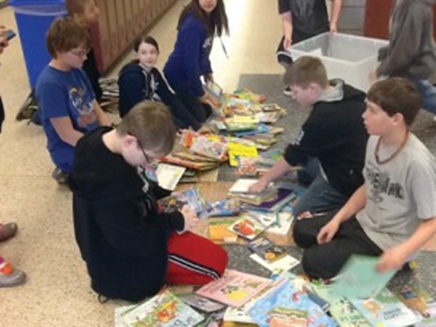
Book Drives!
This year our 5th and 6th graders collected over 5,000 books!
One elementary school collected 2,000 books!

Slide 16
Book Giveaways:
Children’s Fair (about 3,000 books!)
Science Camp
Team Up to Green Up
Other requested events!

Slide 17
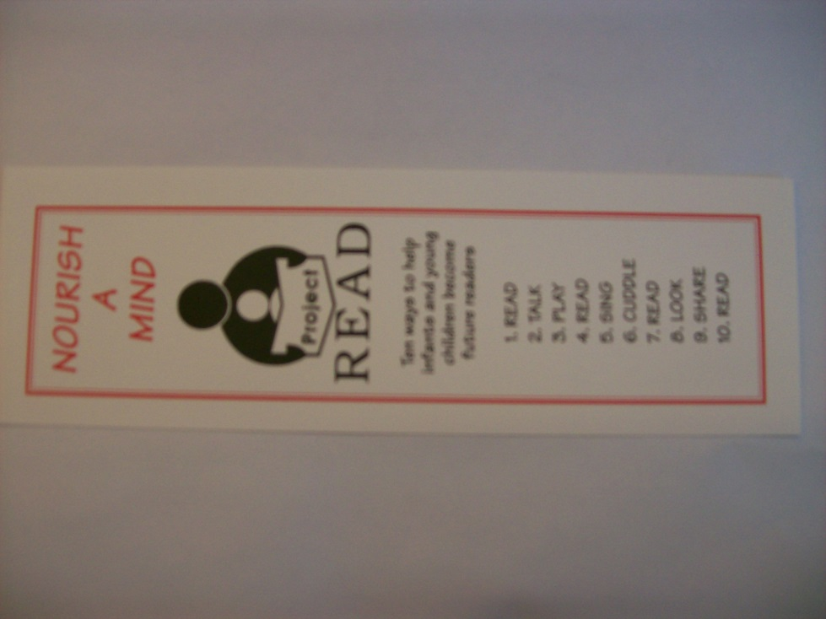
The usual stuff: bookmarks, magnets, window clings…

Slide 18
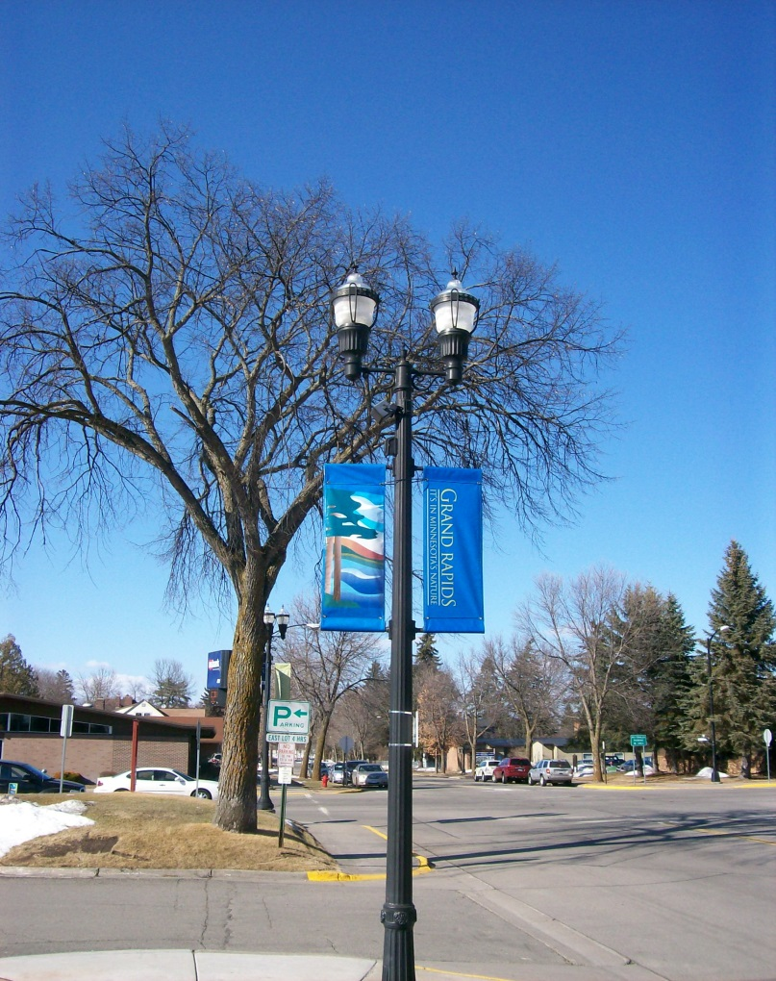
Streetlight banners!
(That kinda look like these, but are red, white, and black, and have the Project Read Logo, and say “Have You Read to Your Child Today?”) Yeah, otherwise they’re exactly like these…

Slide 19
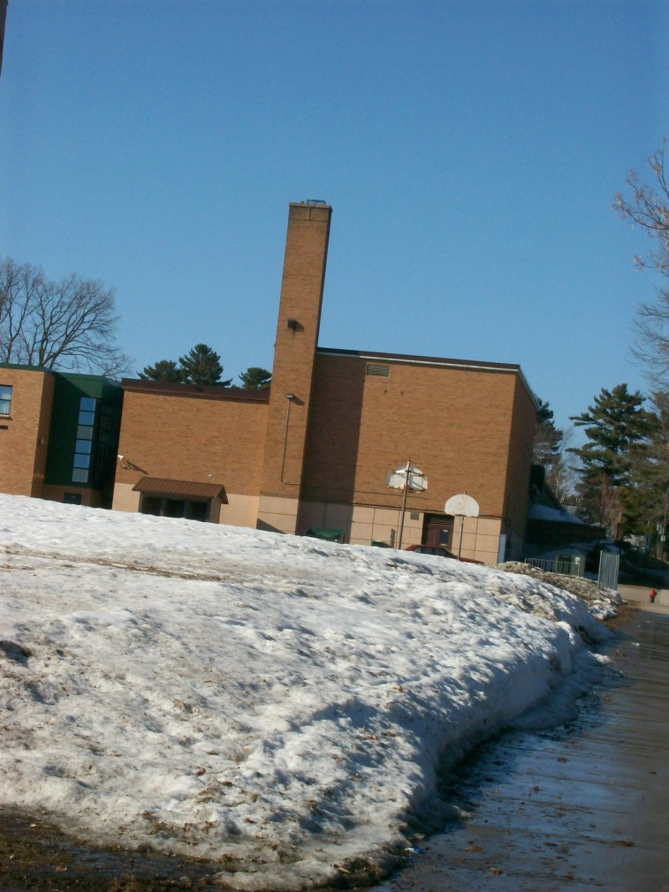
“Have You Read to Your Child Today?” banners hanging at local schools. (Umm, but not actually in this picture, because they are better in fair weather, and aren’t back out yet!)

Slide 20
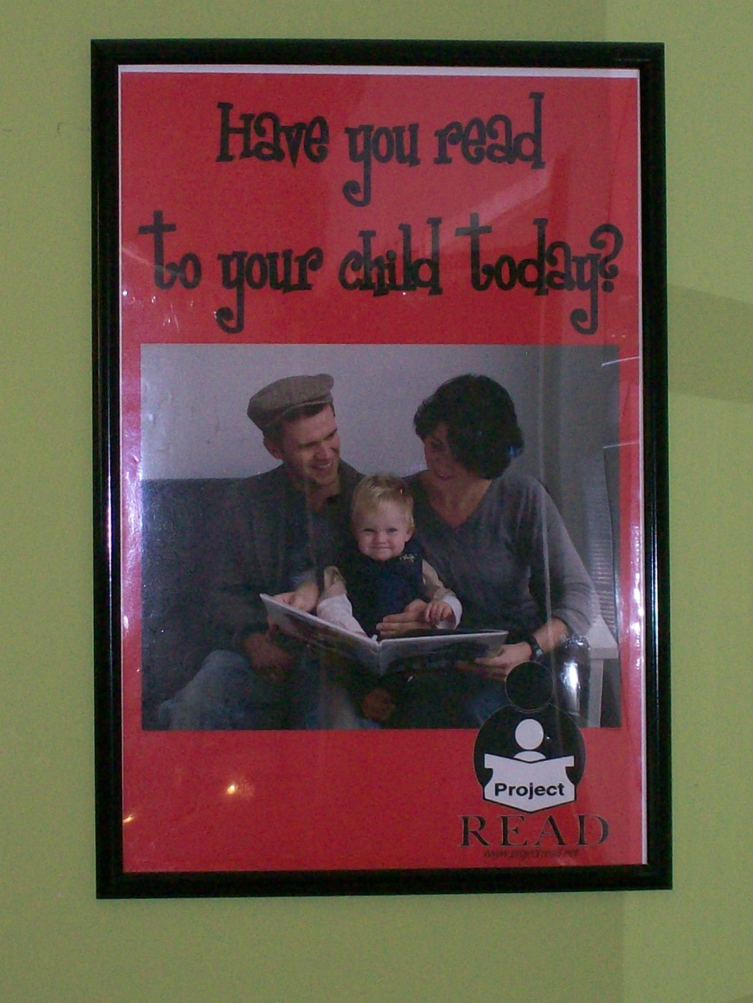
The Poster Project!
Hung at local businesses, featuring employees of that business!

Slide 21
All of this started with
one good idea
And continues to
Grow!
(What’s your good idea?)

